Slide 1
SMART HEALTH: AN INTERACTIVE COMMUNITY HEALTH MONITORING SYSTEM.
PRESENTER: ALBERT RAY MUKIIRA. | ADMISSION NO: BSIT/27204/0/23 SUPERVISOR: MR. PETER OBIRIA | MADAM. SHEILA MIRENJA

Slide 2
Background Information.
In many parts of Africa especially in the rural set up, access to proper health care services was and also remains a problem for many years.
Community health workers have played a crucial role in bridging this gap by providing health services and monitoring health indicators for communities.
However, their effectiveness had been greatly hampered by a number of challenges and one of the major ones was a lack of efficient data collection, report and predictive systems.

Slide 3
Problem statement.
Traditional health monitoring systems were insufficient in tracking public health trends and identifying early warning signs of potential outbreaks.
This led to difficulties in addressing health concerns especially in places whereby resources are quite scarce.

Slide 4
General objective.
To create a unified system that would monitor and support community health in real time and support proactive wellness management.
Specific Objectives.
To study the state of art in community Health monitoring systems.
To identify the challenges in the current systems used to monitor community health.
To develop an interactive community health monitoring system.
To validate and develop systems in rural areas.

Slide 5
Research questions.
What are the challenges facing the current systems used to monitor community health?
Why do we need to develop an interactive community Health monitoring system in a rural set up?
What is the state of the art of current community health monitoring systems?
How can an improved version of the current health monitoring system be implemented?

Slide 6
Justification.
An improved Community Health Monitoring System would give patients easier access to personalized health insights allowing them to make better decisions about their health.
A smoother, more accurate way of diagnosing and treating patients would be made possible between doctors, nurses and patients, thanks to an easier streamlining of patient data.
The monitoring of health trends in real time would also allow public health administrators to prevent diseases and better allocate their resources.
As a result of all these, results collected could give pharmaceutical companies better insight into what products patients are taking and how they are taking them.
The system would also benefit community health workers, who are many at times are the first link in rural areas. This could be done by providing better tools to track and manage the health needs of patients and families.

Slide 7
State of art.
A similar case study is the use of MOTECH in Ghana which is mainly used to improve maternal and child health outcomes in rural areas of Ghana.
Over time, MOTECH has enabled health care workers in the country to track pregnant women and new mothers which ensures timely access to prenatal care, immunizations of newborns and other related health needs.
MOTECH has also managed to send automated messages and alerts to individuals about their upcoming medical appointments and also provide related health information.

Slide 8
The challenges.
Data Accuracy: Data input by community health workers has led to inconsistencies.
Data Privacy and Security: This has been an area of concern as collection of such volumes of personal data leads to even ethical concerns, especially in un deserved areas.
User Engagement: Users can be resistant to adopting technologies such as a digital community health monitoring system.

Slide 9
The proposed system.
Conducting regular data audits for the system in order to catch inconsistencies.
Access control i.e. Limiting people who can access data to authorized personnel only.
Organizing and conducting trainings to teach users and community at large on the importance of using the proposed system.

Slide 10
Methodology.
The CHMS was based on the Agile Development Model.
This model allowed for flexibility, iterative development, and stakeholder collaboration in an active role.
These features were designed to suit a rapidly changing and a continuously improving kind of project.
Using incremental approach, Agile was able to build a system in phases and enable running early features in front of users and validate that the product was meeting their needs.
Additionally, agile methodology enabled developers to speak to actual end users and develop a system that is better suited to real world needs

Slide 11
System requirements.
The system requirements are divided into two categories:
Hardware Requirements i.e.
Mobile devices. (laptops, personal computers, tablets etc.)
Internet routers.
Backup storage.
Software requirements i.e.
Operating system (preferably Linux based to avoid system crashes).
Python 3.10 or higher.
Pip for package management.

Slide 12
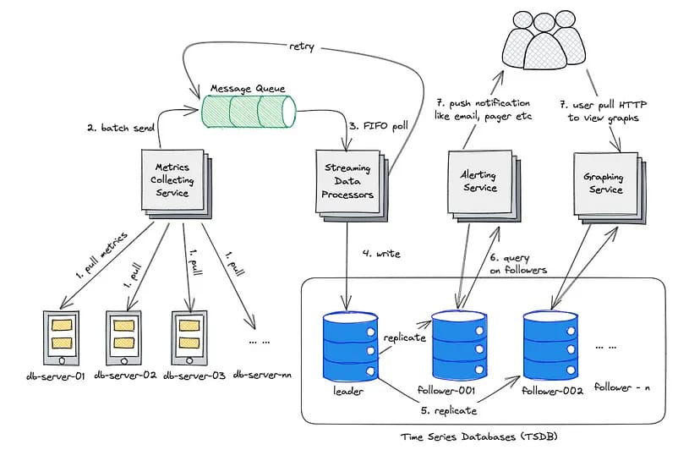
System design.

